Slide 1
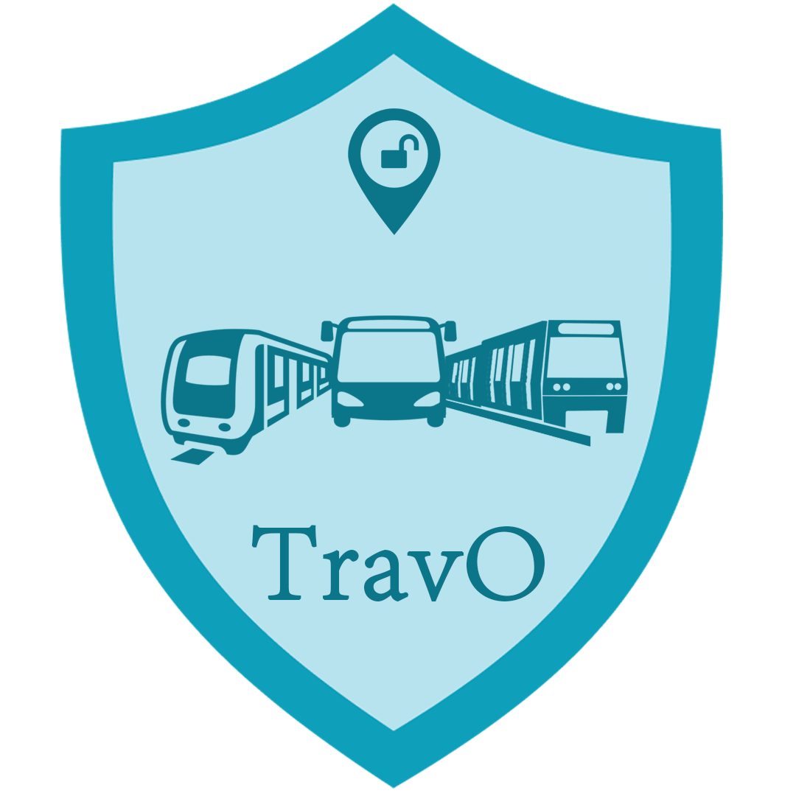
TravO App
Intelligent Demand Driven Transport Management System

Slide 2
TOC
Problem Statement
Understanding the Problem
Project Objective
Expected Outcome
Core of the Idea
Novelty of the idea
Features
Software Dashboard
Business and social impact
Project Timeline
Deploying the System
Introducing: TravO
Spotlight on mobile

Slide 3
Problem Statement
Develop an Intelligent Post-Lock Down Management System for an economically viable Public Transportation which also enhances user or travellers safety, comfort and convenience.

Slide 4
Understanding the Problem
Covid19 pandemic and its severe broad spectrum impact on the whole world brings us to a new era or a new normal. According to the latest report, people all over the world has to live with this virus for some more time to come.The virus spreads on person to person contact with the affected person, exposure to the surfaces he has touched, sharing the close proximity with the affected etc.Facilities like public places, public transport and other public facilities are expected to be the major points of transmission for Covid-19. Thus every government has produced guidelines for travel restrictions which affect both public transport operators and those who use public transport. The emerging issues are many. First is that, operators cannot allow maximum passengers as permitted earlier. Second is that people have minimised their travel because of government restrictions and fear of contracting disease. These two factors alone will create disparity in the earlier existed demand and supply.

Slide 5
Understanding the Problem(CONTD...)
Some of the significant problems emerge because of this is that many trips of operators will be unviable because of lower occupancy and so they are likely to cancel trips in the long term. Such a situation will result in people to wait for indefinite time to get a transport facility.This will create cascading effect on the entire business model of public transport which will result in incurring heavy losses for them. A solution to track demand specifically and optimising transport frequency according to the demand will be the key to solve this issue.

Slide 6
Project objective
To create an intelligent system that efficiently manage the public transport facilities for the passengers to have a safe journey based on demand and supply and for the transport providers to optimise facility so as to attain economic viability . Here we create a system to track demand by customers or travellers with their specific data points related to date and time of travel, pick up point or operators station, destination for travel etc using an App. Thus we can pool all the probable passengers on a particular date and time from a pick up point to their destination conveniently.Intimation will be made available to the respective passengers well ahead of time with a provision to make online payments. Once they confirm the journey, operators will arrange transport to ply as per the route suggested to make the journey comfortable for the user and economically viable for the operator

Slide 7
Expected Outcome
An Intelligent app that provides the following:
1. Enables users or travellers to post their date and time of journey, pick up point, travel destination, etc
2. Getting confirmation from the user
3. Transferring data to the Transport company to fix viable routes
4. Getting confirmation of date and time from the travel company.
5. User making payments

Slide 8
Expected Outcome(CONTD...)
6. Giving confirmation to users or travellers regarding their ticket number or the coupon number, Vehicle Number, time and date of journey, probable departure, arrival time at destination and PREPAID OR POST PAID status – if payment option is provided.
7. Rating the App.
8. Asking residual users to seek optional convenient timing for travel, based on the next viable timing.
9. Repeating the process to see if the last user is given acceptable options.
10. Option to book for a week or a month with travel concessions or with some privileges.

Slide 9
Expected Outcome(CONTD...)
This schedule the timings of transportation will avoid the following:
1. Over occupancy or less occupancy of public transport can be mitigated.
2. Unnecessary crowding at stations (to avoid social distancing).
3. Enhances user experience, by reducing total travel time as the waiting time is optimised.
4. Economic viability of public transport system.
5. Encourage people to use public transport.

Slide 10
Expected Outcome(CONTD…)
6. Develop scientific data of people who travel frequently.
7. If prepaid facility is provided, it will avoid customer- conductor ‘touch points,’ which is crucial in managing post Covid19 period by social distancing.
8. Uncertainty in travel will be reduced on both ends.
9. Reduces pollution as a small part of vehicle owners will prefer to opt for public transport as there is comfort, convenience and less crowd in the new system.
10. Make the public transport to forecast travel requirements scientifically and make them resourceful to design viable travel route based on empirical data.

Slide 11
Core of the Idea
We are creating an application which act as an information provider for travel. Evolve as an easy and comfortable portal to book for travel facilities.Provide 75% seats for online booking and 25% to address the immediate passengers who make travel for an emergency.Regular and daily passengers can book tickets for a week or for a month. Hence they can avoid overcrowding.A live update of the seats in the public transport will be updated regularly.

Slide 12
Novelty of the idea:
Addresses social distancing issues to a great extent and a few concerns of Covid19 Protocol.Avoid overcrowding at the bus stops Satisfying demand appropriately.Facilitates both the passengers and the public transport facility.Becomes an ALL-IN-ONE booking solution system for region specific public transport.Reduces transmission of Covid19 and other communicable diseases Enhances confidence of passengers to travel by public transport Improve economic activity as people feel free to move out The public transport need not run at a time when there is no demand. The people doesn’t have to crowd at the bus stops. The public transport can work efficiently. Most user friendly approach that suites both passenger and transport system.Reduce pollution as people who use own transport will get attracted to subscribe this.

Slide 13
Features
The public transport information will be provided with an ETA (estimated time of arrival).So the passengers are well informed well ahead of journey.
Out of the booking seats, if no one booked, then these seats will be available for occupation for the immediate or emergency passengers.
A live update of the seats in the buses will be updated. So if the transport is full it will not be available for the users.
When the ticket is issued, the live update of the public transport shows its occupancy of seats. The tickets when issued from the issuer also gets updated.

Slide 14
Features(CONTD...)
Suppose a public transport start with full capacity from a station and when a passenger gets down at a nearby station, a vacant seat will arise from that station. In such cases the passengers will get intimation regarding the revised status of a vacant seat.
A toll-free number for the booking of tickets will be provided for ordinary people who don’t own a smartphone. Thus they also can participate in booking tickets.
The payment of ticket (pre-paid) will be accepted online or post-paid payment option will be given (From the conductor or ticket issuer).
The people booking from the toll-free number can pay when they get in the public transport or their respective ticket issuer.
Store data of commuters will be vital for contact tracing and other Police investigation

Slide 15
Feasibility and Viability of the Product
Feasibility:
It can be easily promoted by a private operator or by government using various advertising platforms.
The application we are trying to implement will be very light which requires less disk space.
It can be made available to install from Playstore.
Viability:
We aim at providing real-time updated data.
It is right time to implement as it will become an efficient way to manage crowd and
thereby to stop community spread. It can also manage public transport smoothly.
An individual is only required to install the App with their limited personal details.

Slide 16
Software Dashboard
The app welcomes the user to a home screen, and then leads to a page where they have two options either to book or check availability of their respective medium of public transport (bus, train or metro’s) by choosing date and time, the place to get in and get down. (From and to stations or bus stop).

Slide 17
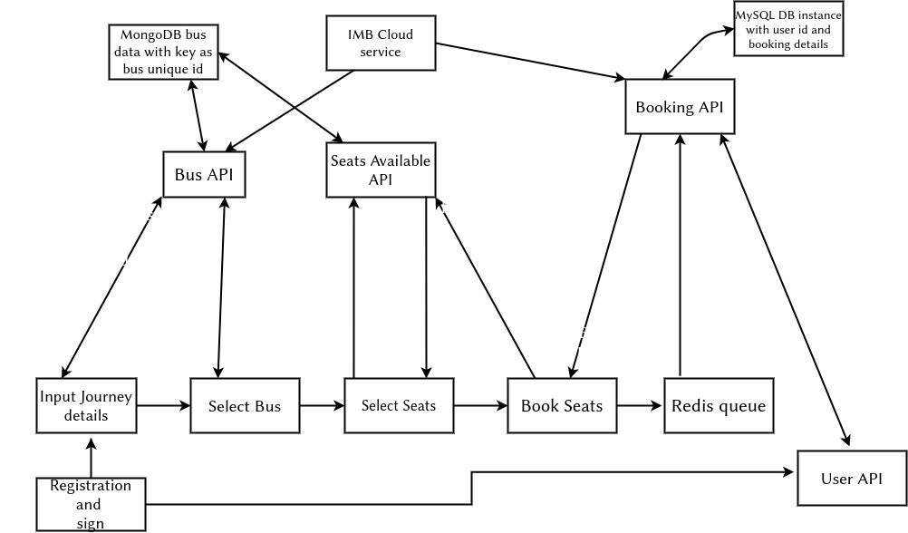
Data Flow Diagram

Slide 18
Business and social impact:
Public transport will be economically viable with lesser unviable trips Predictability of public transport will enhance more business for transport system
Access to travel and customer data and their preferences will enable transport providers to develop new models and enable them for more customization.
Convenience and comfort of travel will improve
Travel will be hassle free for the public
Long term subscription model is likely to emerge
If the passenger uses the live status update feature of the application, then the passenger need not get down from their house if the bus is completely occupied.
The application is not only user-friendly but at the same time it takes care of the public’s health and exposure to contagious diseases like Covid19.
Data of commuters facilitates contract tracing of affected people.

Slide 19
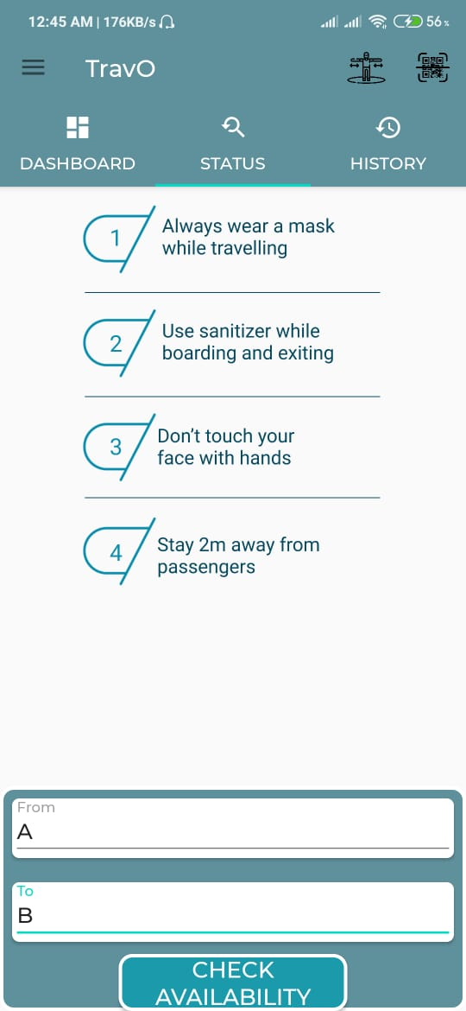

Introducing: TravO
Spotlight on mobile
The app welcomes the user to a home screen, and then leads to a page where they have two options either to book or check availability of their respective medium of public transport (bus, train or metro’s) by choosing date and time, the place to get in and get down. (From and to stations or bus stop).

Slide 20
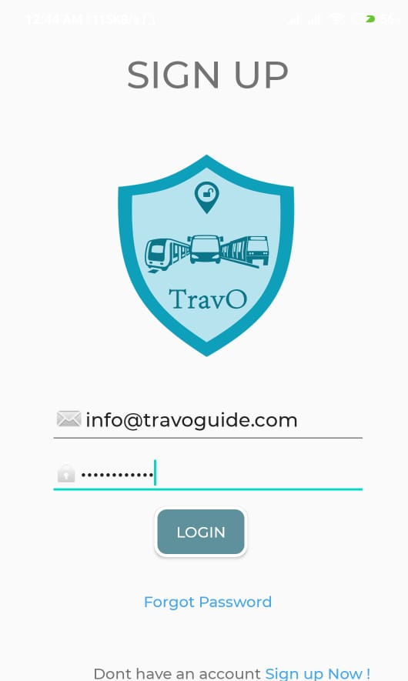
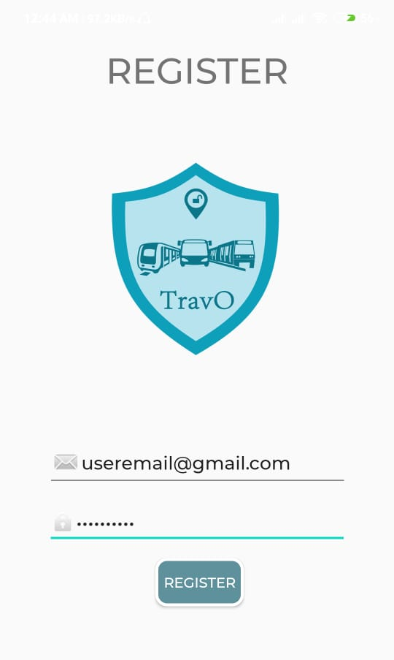
Some Screenshots of our App
Membership

Slide 21
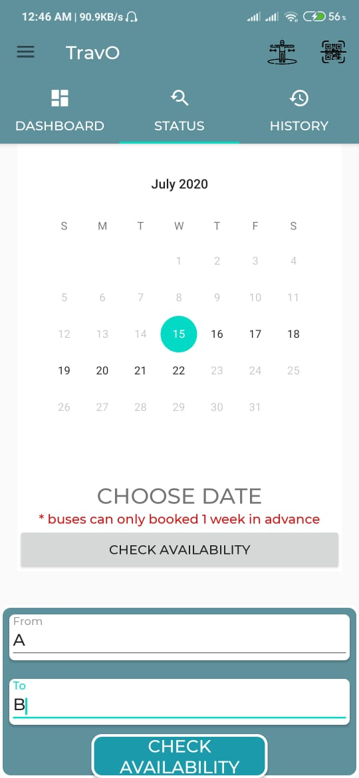
Checking the Availability of
Vehicle for a particular date

Slide 22
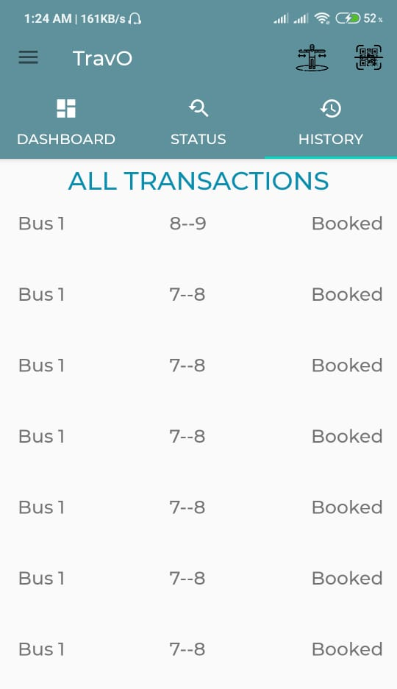
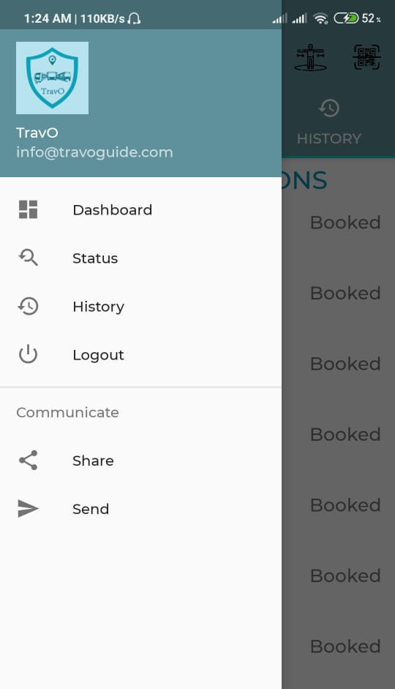
History section

Slide 23
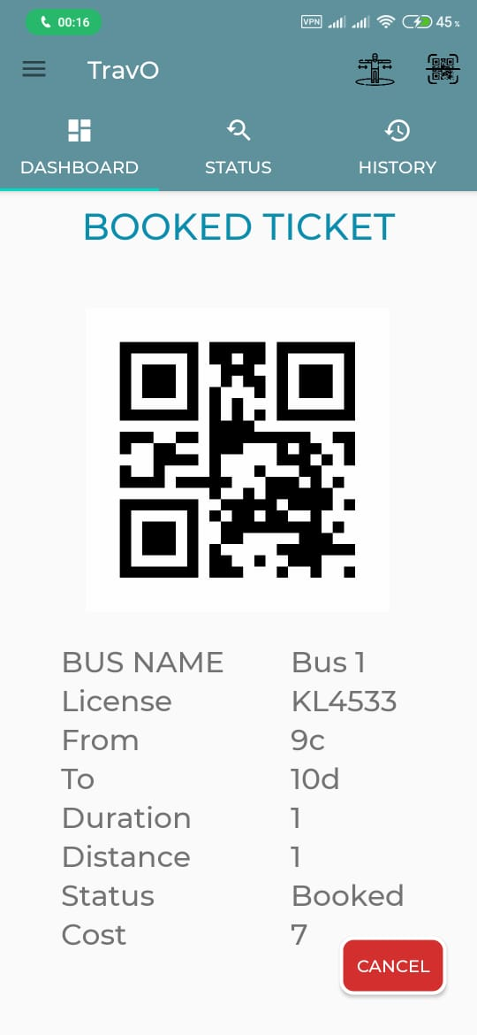
Successfully Booked Ticket

Slide 24
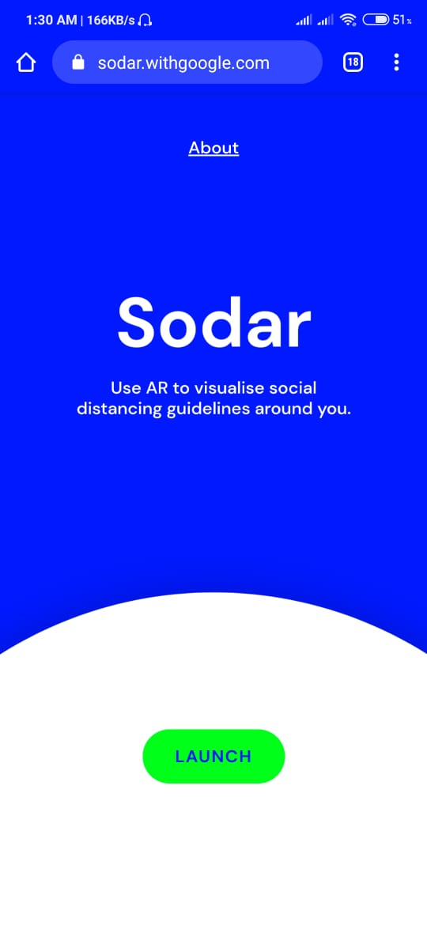
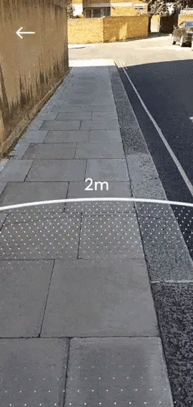
Google SODAR
Social Distancing made easy
This is integrated to our app

Slide 25
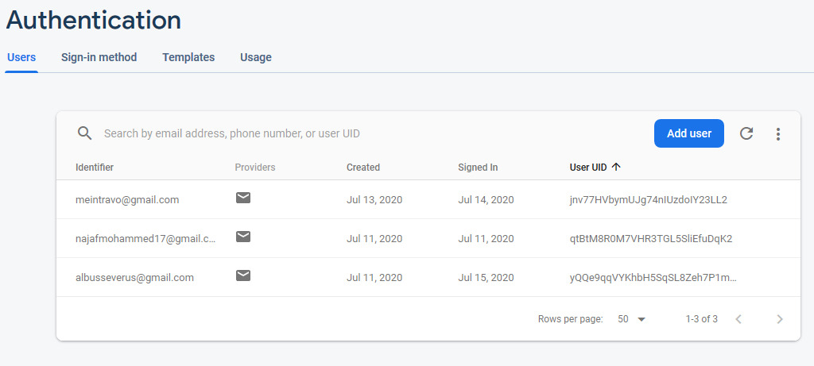
Server Side
Dashboard:

Slide 26
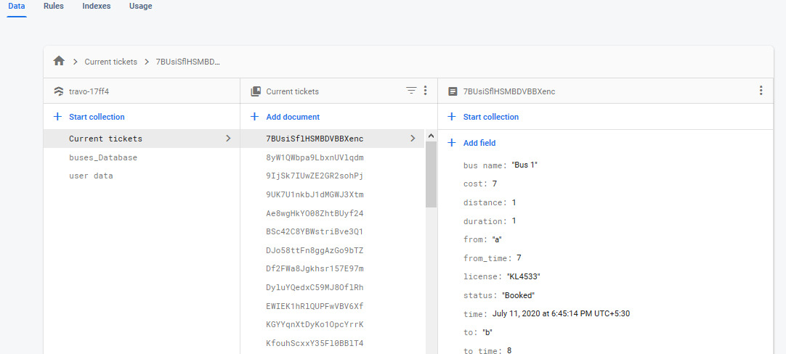
Server Side
Database:

Slide 27
Project timeline
STAGE 1
STAGE 2
STAGE 3
STAGE 4
STAGE 5
STAGE 6
Login, Login interface
Token Generation
Membership and feature utility.
Payment Setup
Live Updation
Issue fixes
From: , To: , Date:
Current Status of teansport feature
Token generation (Postpaid payment customers) and other web feature add-ons.
Payment successful feature with SMS and dashboard update.
Live updation and its fixes.
Frontend and backend fixes and improvement.

Slide 28
Expansion of the concept:
If the demand is less than the seats in the normal public transport (bus, train, metro’s), then we are trying to include small seater public transport to cater to such demands to optimise costs. (mini bus, small tempo’s in case of road transport and others). It will also increase the revenue for the operator.The transportation booking facility is in the ratio of 3:1 for online booking and immediate passengers respectively. Now, the ultimate crowd-management lies in managing the 25% of the immediate passengers.
Each bus stop / station will carry a QR code.
The immediate passengers can scan it, to obtain tickets.
If the ticket is obtained by the above method. Then the application updates the respective seats. Hence, those who are planning to leave house for a particular time can stay at home and reduce public exposure.

Slide 29
Deploying the system:
It is also known as “Ready to go”, “Ready for Production” and “Serving Application”.
Basically a cloud deployment refers to the enablement of SaaS (Software as a Service),
PaaS (Platform as a Service) or IaaS (Infrastructure as a Service) solutions that may be
accessed on demand by end-users or consumers. A cloud deployment model refers to the type of cloud computing architecture in which a cloud solution will be implemented on.Cloud deployment includes all of the required installation and configuration steps that must be implemented before user provisioning can occur.
We are planning to implement a SaaS solution to the clients. As it can provide scalability
where application users can be added or subtracted on demand without concerns over
capital investments with additional hardware or software. SaaS deployment also provides above average up-time for enterprise applications as compared to, on-premise software deployment. After cloud deployment has been completed for a SaaS solution, user provisioning can occur based on user permissions, where access is provided for cloud resources based on the consumer’s classification as either a trusted or untrusted entity.

Slide 30
Thank you!
Developed by :
Najaf Mohammed
Janus Jerom
Anadhakrishnan G M
Sanju Thomas
TravO an app
by XLSolution

